Slide 1
SHSU Innovation Day
NSF I-Corps Overview
September 25, 2024

Slide 2
Some
History
Launched in 2011, I-CorpsTM is an NSF program that prepares scientists and engineers to extend their [research] focus beyond the university laboratory — accelerating basic research projects that demonstrate commercial potential.
I-Corps addresses four national needs:
Training an entrepreneurial workforce
Translating technologies
Enabling positive economic impact
Nurturing an innovation ecosystem

Slide 3
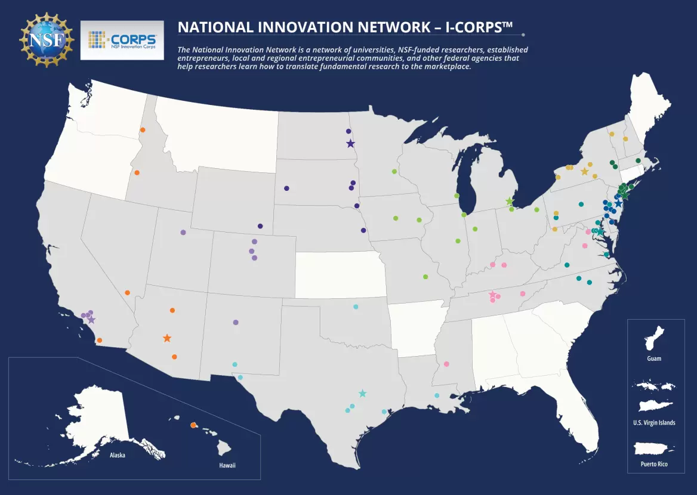
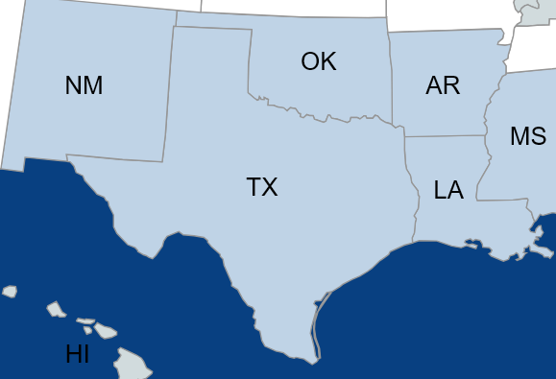
National Network
Southwest Region

Slide 4
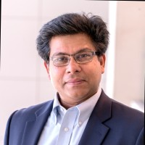
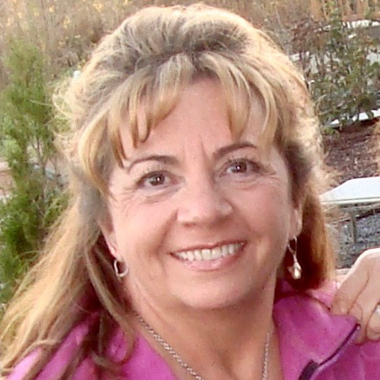
Saurabh Biswas, PhD
Executive Director
Texas Engineering Experiment Station
Texas A&M University System
saurabh_biswas@tamu.edu
Lenae Scroggins
Program Manager
Texas Engineering Experiment Station
Texas A&M University System
lenae@tamu.edu
Key
Contacts
Kerri Smith
Executive Director
Rice Alliance for Technology & Entrepreneurship
Rice University
kerri@rice.edu

Slide 5
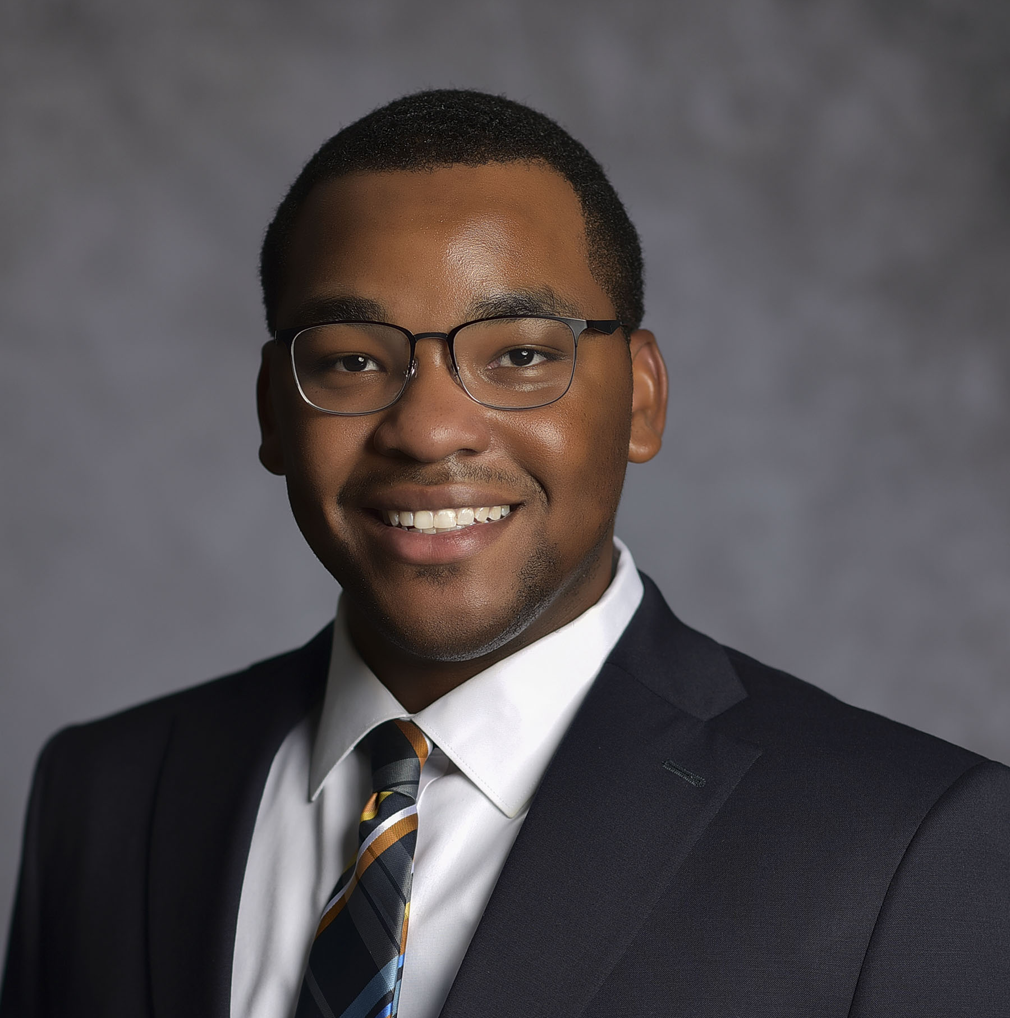
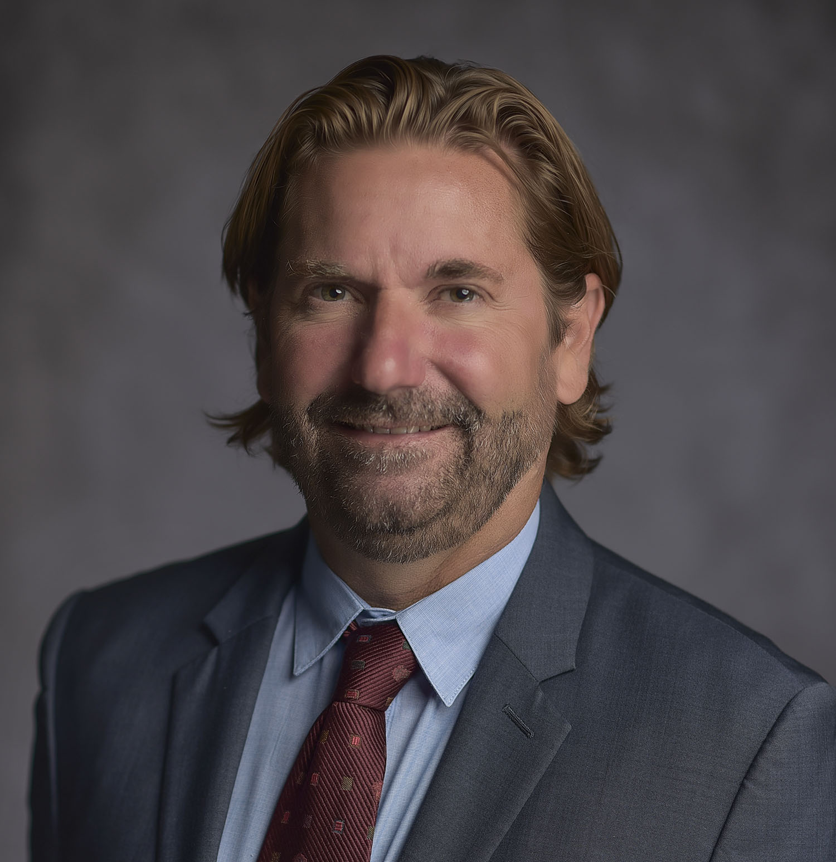
Jonathan Thomas
Director of Strategic Partnerships & Technology Transfer
Sam Houston Houston University
jxt106@shsu.edu
Key
Contacts
Chad Hargrave
Vice President for Research & Strategic Partnerships
Chief Research Officer
Sam Houston Houston University
cwhargrave@shsu.edu

Slide 6
Why would you be Interested?
Learn where your technology has value and to whom.
Learn about methodologies that reduce time-to-market.
Identify potential markets and potential barriers for adoption.
Expand your network.
Increase your access to resources.
Receive a $50,000 NSF grant (awarded to the university)
6-month grant
7-week course

Slide 7
What are some program outcomes?
Refinement of the following:
Is there a clear problem or need your technology addresses?
Who are the buyers or customers? Or the end users?
Are those customers willing to pay? Is it enough?
How do you reach those customers? How are they reached now?
Is there commercial or scalable potential?
Is your solution significantly better than current solutions? How much is enough?
Notes:
.

Slide 8
What does the course entail?
3-day opening workshop
Business Model Canvas introduction
Customer Discovery Methodology
Customer Segments
Value Propositions
5-weekly sessions + team presentations + office hours
Distribution Channels
Customer Relationships
Revenue Models
Partnership Strategy
Key Resources / Costs
2-day closing workshop
Final presentations (lessons learned)
Team video (2 mins)

Slide 9
What does an I-Corps team look like?
Entrepreneurial lead (EL)
A graduate student or postdoctoral scholar with relevant knowledge of the technology and a commitment to investigate its commercialization potential.
Serves as the team lead and drives the customer discovery process.
Time commitment is ~20 hours/week
Technical lead / Principal Investigator (TL/PI)
A faculty member who was involved in creating the technology that forms the basis of the team’s business concept -- or -- possesses a high level of relevant technical expertise.
Manages the proposal and post-award process
Assists with the customer discovery process.
Time commitment is ~10 hours/week (unpaid)
Industry Mentor (IM)
An experienced entrepreneur, intrapreneur or corporate innovator.
Guides the team, helping to navigate industry sectors and assist with introductions.
Teams do not have to identify an IM prior to application but are strongly encouraged to do so.
Time commitment is ~10 hours/week (unpaid)
*Co-ELs, co-TLs and co-IMs are allowable – but everyone must actively participate.

Slide 10
Eligibility Pathways
In all cases, the innovation or research
Should (ideally) be university-based IP and related to previously awarded NSF grants
Should demonstrate commercial promise for translation into a product, process or service
Should be a ‘deep tech discovery’ from fundamental STEM-based research
Pathway 1: Existing NSF lineage
The team/PI has a current NSF funding history
The NSF award has not expired >5 years ago
The team composition must be acceptable to NSF
Pathway 2: Regional Endorsement
If not already established through Pathway 1, the team must achieve endorsement from any I-Corps Hub after successfully completing a regional program

Slide 11
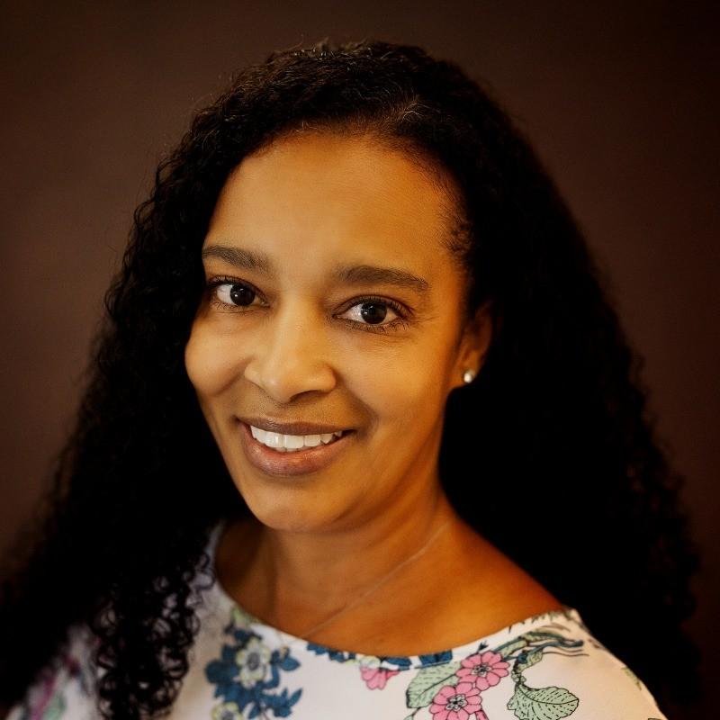
Bob Milner
Director of Entrepreneurship
Sam Houston Houston University
rlm088@shsu.edu
Peer
Engagement
Theresa Johnson
Graduate Student
Sam Houston Houston University
ttj008@shsu.edu

Slide 12
NSF I-Corps™ Survey
Teams are asked to complete a survey regarding their I-Corps™ participation.
The survey is conducted by Venture Well and the purpose is to collect baseline data about you and your team.
De-identified responses and data are shared with the NSF for evaluation and reporting purposes.
Longitudinal Studies

Slide 13
Teams must first establish lineage:
If the team has no NSF lineage, they must complete a free regional I-Corps program
If the team has already established NSF lineage, they proceed to the next step*
Once lineage is established:
Submit an Executive Summary.
Optional: The Southwest I-Corps Hub can provide an advance review of the executive summary
If NSF likes your executive summary:
Your team will be invited to sign up for a virtual interview with an NSF Program Manager
Optional: The Southwest I-Corps Hub can assist with interview prep
If NSF likes your team interview:
You will be invited to submit a proposal through your Sponsored Research Office in response to Solicitation 21-552.
You will be invited to select a preferred cohort.
For more info:
About: https://new.nsf.gov/funding/initiatives/i-corps/about-teams
Webinars + Resources: https://new.nsf.gov/funding/initiatives/i-corps/webinars-resources
FAQ: https://www.nsf.gov/pubs/2018/nsf18057/nsf18057.jsp#q6
What does the application process look like?
* The NSF may still recommend the team complete a regional program

Slide 14
$50,000 grant to the university
Indirect Costs - $5,000
Capped at 10%
Course fees - $4,500
Course materials + registration fees
Customer Discovery costs - $10,000
Conference registration fees
Travel, lodging, ground transportation
Reasonably justified expenses to advance commercialization efforts
Tech Tools
LinkedIn Premium membership
Video conferencing services
Entrepreneurial Lead (EL) support
Paid as a stipend through the university
Prototype materials and equipment – <$5,000
May require NSF approval
Budget Considerations

Slide 15
The Southwest Hub can assist with
the application process
team formation
mentor identification
executive summary review
interview preparation
More information here:
https://new.nsf.gov/funding/initiatives/i-corps
How we can help!

Slide 16
SHSU Innovation Day
Let us know how the
Southwest I-Corps Hub can help you!

